Slide 1
INNOVATION LAB PROJECT
Smart Lock Using Face Recognition
YASH GARG
1801CS62

Slide 2
About my Project
I have done this project under the supervision of Dr. Somanath Tripathy. This is a project under the course innovation lab.
Ever wanted to add a little bit of extra security to your shelf, drawers, wardrobes or doors at home?
When it comes to innovation using internet, among thousands of platforms and tools available to us, ESP 8266 module stands out as it provide us with wifi connectivity.

Slide 3
OVERVIEW OF THE PROJECT
In this project I have made a smart door lock using solenoid lock and esp8266 module.
After making the hardware we made a face detection and recognition software
We use deepnote and some python libraries (face_recognition, numpy as np, Image, ImageDraw ) for the face recognition.

Slide 4
Applications:-
Security
Criminal investigation
Business
Health sector

Slide 5
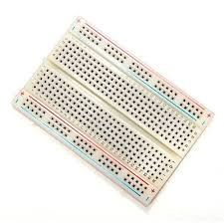
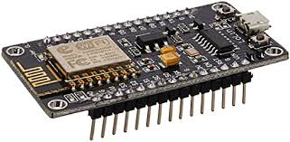
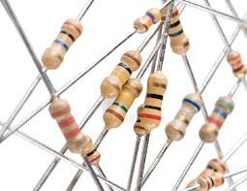
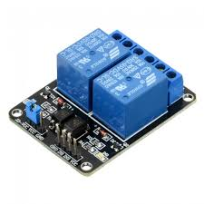
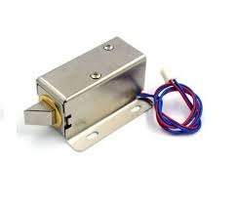
Things used in this project
Breadboard
ESP8266 wifi module
Some resistors
Jumper wires
Batteries
Solenoid lock
Relay module

Slide 6
Software apps and online services
Arduino IDE
Microsoft windows 10
Language used ->Python,C++
For face detection and recognition I used the deepnote website to run and simulate my code.

Slide 7
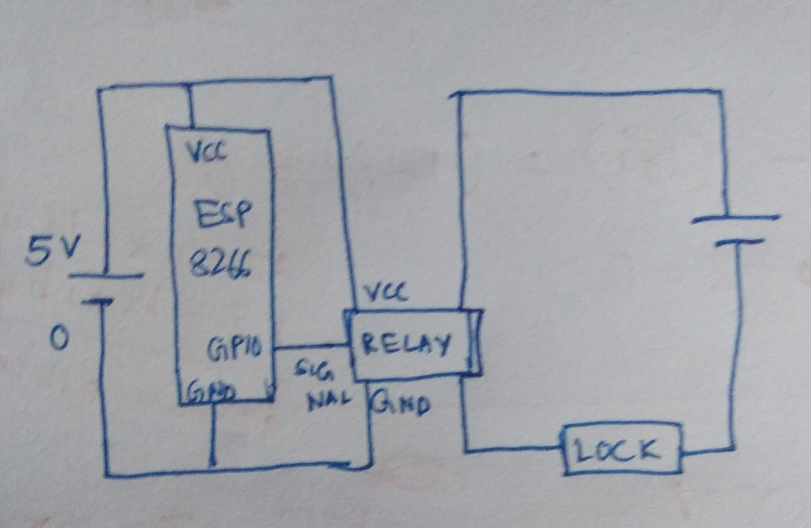
How it’s done
Step 1:-Circuit Design
Circuit Design is as shown below

Slide 8
Step 2:-Building the hardware
Firstly we make the hardware part of the project by connecting the wires on the breadboard
Then connecting all the components together as shown in the circuit diagram.
After that install the lock unlock code in the esp8266 module with the help of a cable wire.
And we are done with the hardware.

Slide 9
Step 3:-Face detection and recognition.
We start by loading an example picture using Python Imaging Library (pillow).
from PIL import Image, ImageDraw
from IPython.display import display
pil_im = Image.open(‘image_name.jpg')
display(pil_im)

Slide 10
How It works?
Face
Detection
Features
Extraction
Face
Recognition
Features:-
Distance between eyes
Width of nose
Depth of eye socket
Cheekbones
Jawline
Chin

Slide 11
TRAINING
Now after loading the initial image of all the faces that are authorised to unlock the door.
Now we have to train our program to recognise those faces and for that we have to upload some images of these people.
After training the program we can use our program to recognise that image.

Slide 12
Training phase:-
Capture
Images
Face
Detection
Save
Features
Extract
Features

Slide 13
testing
After training the software we can upload another unknown image of any person to check if our program recognise that image.
If this person is stored in our program then the program will make a box around the face with the “name” saved with that image.
Otherwise the box will be created with text “unknown” on it.

Slide 14
Testing phase:-
Capture
Images
Face Detection
Extract Features
Compare known faces from disc
Match?
YES->
Send signal to
ESP
NO->
Ignore

Slide 15

Testing the software
Inserted image

Slide 16
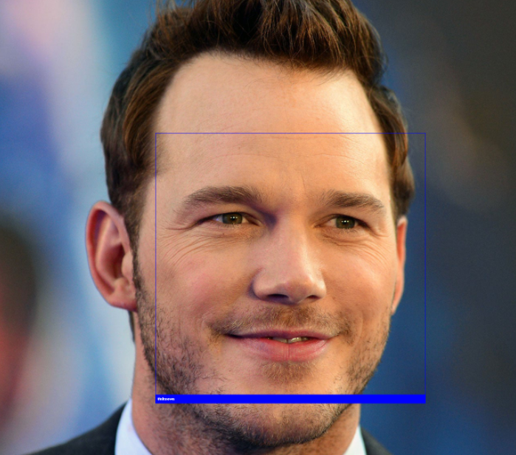
Results = “Unknown”

Slide 17
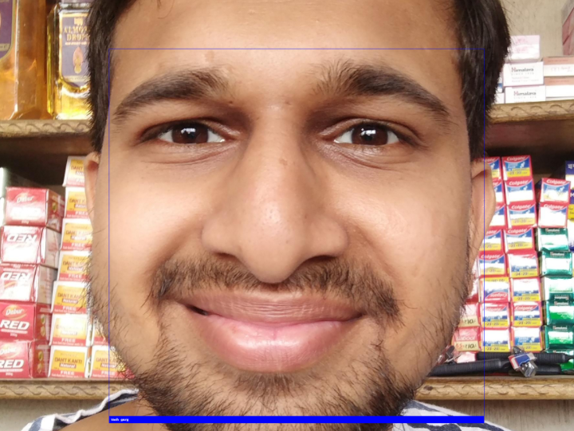
Results = “Yash garg”

Slide 18
Lock unlock
Now to connect this code with our esp8266 module.
We will send a high signal to the wifi module whenever we have a recognised face
Otherwise the signal is low and the lock will not open.
LOGIC:-If the name variable is still “unknown” after processing
Then the program will not send any signal
Otherwise it will send a signal and the lock will open.

Slide 19
INNOVATION
I have made a program which recognises all the the faces in the image.
If there is any known face present in the image it will open the lock by sending a signal to the esp module.

Slide 20
THANK YOU

